Slide 1
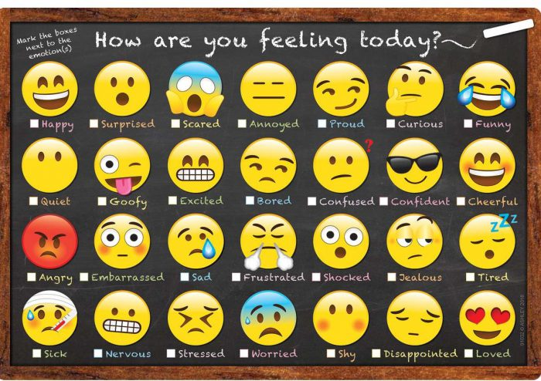

Slide 2
Supporting Social Emotional Learning in a Virtual Classroom
Created by PIRS:
Ms. Berger, Ms. Torres, Ms. Smith, & Ms. Strelec
Orange Public Schools (Early Childhood Department)

Slide 3
AGENDA
Define Social Emotional Learning (SEL)
Discuss the Importance of SEL
Discuss the Benefits of SEL
A brief overview of SEL competencies
Share Strategies in Supporting SEL in a virtual environment
Q and A

Slide 4
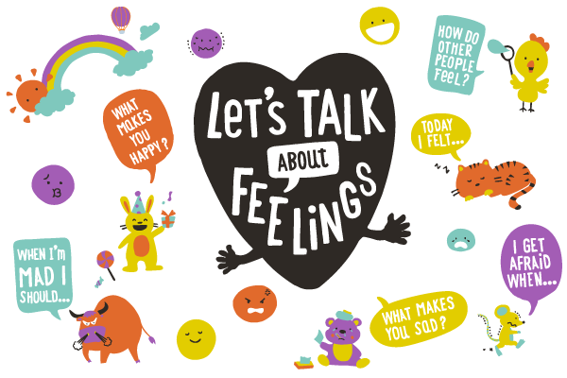
What is SEL?
Social and emotional learning (SEL)
is the process through which children and adults understand and manage emotions, set and achieve positive goals, feel and show empathy for others, establish and maintain positive relationships, and make responsible decisions.
– CASEL 2020
(Collaboration for Academic, Social, and Emotional Learning)
Notes:
CASEL- The Collaborative for Academic, Social, and Emotional Learning

Slide 5
Why is SEL important?
“Educating the mind without educating the heart is no education at all.” –Aristotle
Social and emotional learning (SEL) provides a foundation for safe and positive learning, and enhances students' ability to succeed in school, careers, and life.
Beginning early in life, social and emotional learning (SEL) is highly important for helping preschool children to understand and manage their emotions, feel and show empathy for others, establish healthy relationships, set positive goals, and make responsible decisions.
Notes:
Address behaviors before academics, children can’t learn if they have behavioral issues,
Research shows adults getting a job is easier than keeping it due to poor social skills

Slide 6
BENEFITS OF SEL
Academic success. Developing stronger social/emotional skills improves the academic performance of students.
Fewer behavioral problems. Students engaged in SEL are less aggressive and disruptive in school.
Less emotional distress.
Positive social behavior.
*Research shows that SEL not only improves achievement by an average of 11 percentile points, but it also increases prosocial behaviors (such as kindness, sharing, and empathy), improves student attitudes toward school, and reduces depression and stress among students (Durlak et al., 2011).
Notes:
Academic success- more confident, feelings are acknowledged and respected– increase school performance
Decrease behavioral problems – can express feelings (eg. Anger) appropriately – prevent from acting inappropriately and damaging relationships
3. Less emotional distress- through SEL, children learn to manage their feelings and not let their feelings take over them, develop stronger self-regulation skills
4. Positive social behavior
SEL need to be learned mostly through observation, experience, and direct guidance. Not everyone has the opportunity to learn such concepts at home.
SEL is a process that requires time, patience, and especially educators that are committed to providing a self and caring learning environment

Slide 7
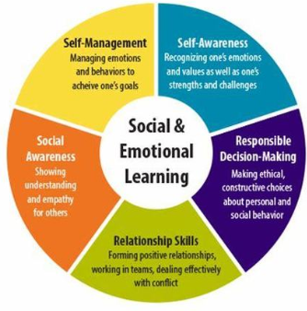
A brief overview of SEL competencies
5 Keys to Successful SEL

Slide 8
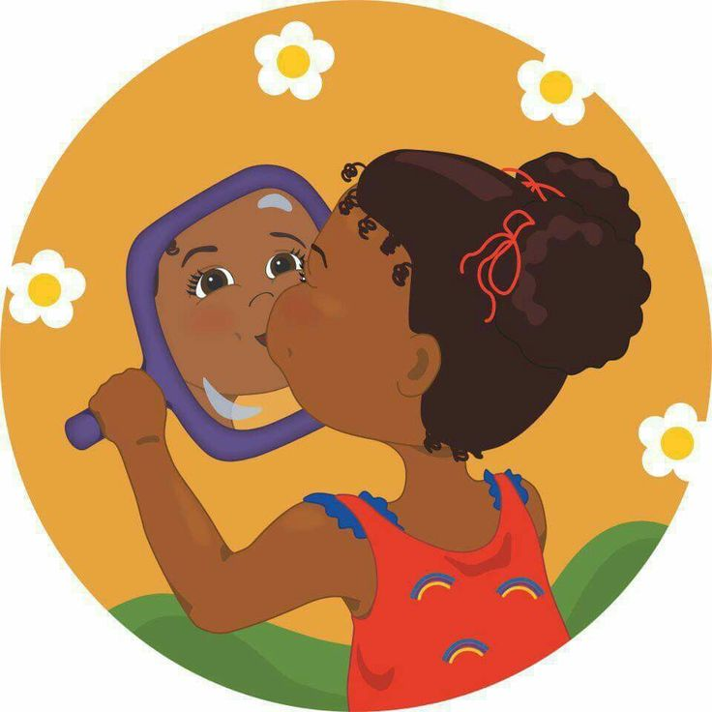
Self-Awareness
Self-awareness involves understanding one's own emotions, personal goals, and values. This includes accurately assessing one's strengths and limitations, having positive mindsets, and possessing a well-grounded sense of self-efficacy and optimism. High levels of self-awareness require the ability to recognize how thoughts, feelings, and actions are interconnected.
VIRTUAL ACTIVITIES:
Check in with your students. Use emotion charts. Teach different emotions using visuals, modeling, using literature, songs/music, and videos
Ask questions such as when you receive hugs, how do you feel? When someone grabs your toy, how do you feel? Teach children to label their emotions
Emotion plate activity using paper plates
Create faces using playdough or string
Notes:
Identifying emotions, needs, strengths and limitations.
Saying your feelings out loud may help- talk about experience with gardening and squirrels, my emotion evolved from angry to sad then I accepted the reality that I won’t have butternut squash this year
Matching activity using cut-out pics from magazines
MOST OF THE ACTIVITIES ARE ON THE PIRS WEB PAGE, https://www.orange.k12.nj.us/Page/25578

Slide 9
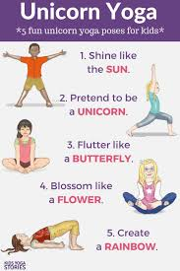
Self-Management
Self-management requires skills and attitudes that facilitate the ability to regulate one's own emotions and behaviors. This includes the ability to delay gratification, manage stress, control impulses, and persevere through challenges in order to achieve personal and educational goals.
VIRTUAL ACTIVITIES:
Meditation/ yoga activities, practice mindfulness
Breathing exercises (five finger breathing, belly breathing, smell the flower, blowout the candle)
Using visuals and modeling for emotional regulation
Calm down strategies (take a break, listen to music, hug a bear, etc.)
Tucker Turtle at Home
*GoNoodle for Families- is a website that engages kids in movement and mindfulness activities that are designed to promote physical wellness, academic success and social emotional health.
Notes:
Managing impulses, emotions, and stress.
EMOTIONAL REGULATION ISN’T INSTINCTIVE, IT’S LEARNED.
MANAGE OUR FEELINGS RATHER THAN OUR FEELINGS MANAGING US.
SHOW MATERIALS
https://www.smilingmind.com.au/ (This webpage offers and explains a free app. Thrive Inside is a special initiative to help you stay calm and healthy in the physical constraints of your home, while remaining calm and healthy inside your mind. )

Slide 10
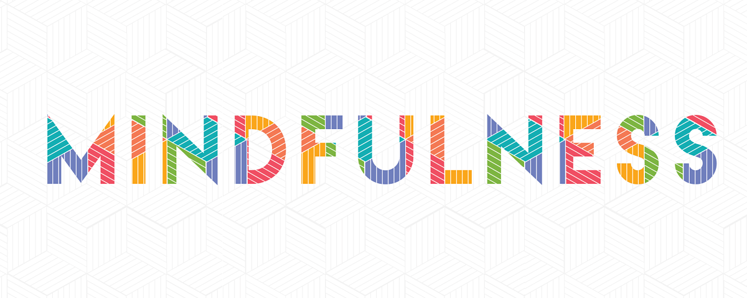
Mindfulness:
the ability to notice what is happening, when it is happening
being aware of one's own self
being able to manage one's feelings and emotions.
Taking time each day to understand your feelings and emotions is essential in setting yourself up for a successful day
Using self-care practices daily will help you be mindful of your feelings, emotions, and social and emotional needs.
Benefits:
Build attention
• Improve focus
• Manage stress
can be used for your students and their families as well to help them become in-tune with themselves and their own social and emotional needs.
Notes:
Benefits: 2016 Study by Frank and Kohler on the effects show a yoga-based program on mental health and school performance showed:
Reduced: absences, detentions, problem behaviors
Increased: engagement and coping strategies
Do virtual yoga as you lead, mindfulness before bed

Slide 11
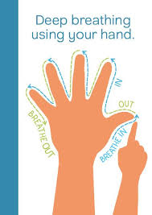
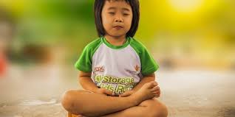
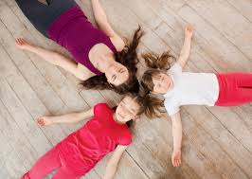
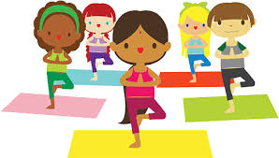
MINDFULNESS VIRTUAL ACTIVITIES:
Take 5 or Starfish Breathing
Yoga Sequences
Mindful Minute
Body Scan/Guided Rest
Notes:
Body scan-This exercise asks you to systematically focus your attention on different parts of your body, from your feet to the muscles in your face. It is designed to help you develop a mindful awareness of your bodily sensations, and to relieve tension wherever it is found

Slide 12
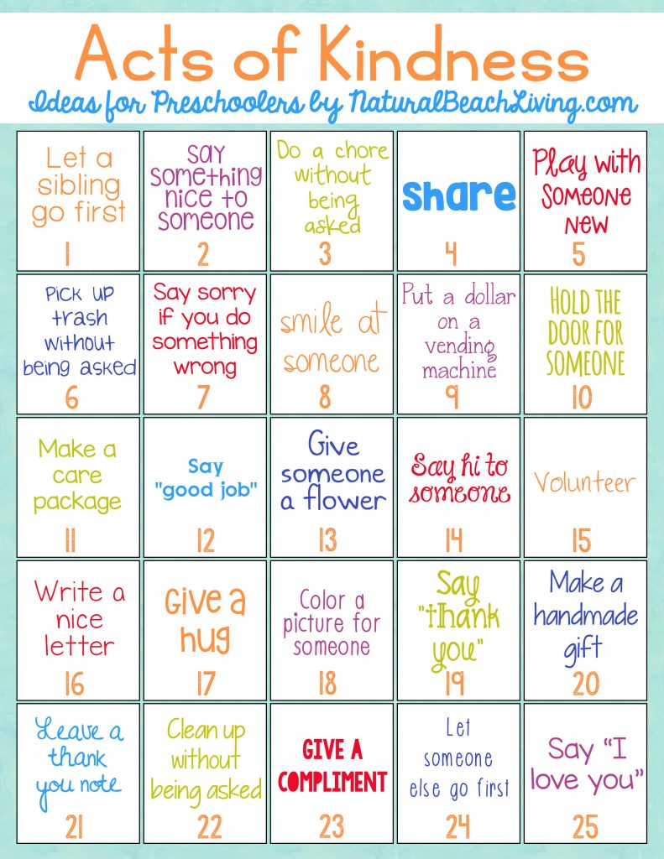
Social Awareness
Social awareness involves the ability to understand, empathize, and feel compassion for those with different backgrounds or cultures. It also involves understanding social norms for behavior and recognizing family, school, and community resources and supports.
VIRTUAL ACTIVITIES:
Encourage children to do random acts of kindness
Encourage children to practice empathy (putting oneself in someone else’s shoes)
Go over rules and review them daily
Celebrate diversity
Notes:
Understanding others and their feelings
Before ending the class, encourage kids to do one act of kindness

Slide 13
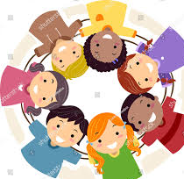
Relationship Skills
Relationship skills help students establish and maintain healthy and rewarding relationships, and to act in accordance with social norms. These skills involve communicating clearly, listening actively, cooperating, resisting inappropriate social pressure, negotiating conflict constructively, and seeking help when it is needed.
VIRTUAL ACTIVITIES:
Have virtual playdates, phone a friend or family member
Play virtual games (scavenger hunt, bingo)
Encourage cooking activities for families to participate
Suggest a family game night, eating meals together at the table, having daily check-in chats to talk about how things are going (www.playworks.org)
Encourage turn-taking/sharing and incorporate in lessons
Encourage students to ask questions and converse with each other
Teach Friendship skills: giving compliments, apologizing
Notes:
Building relationships at home and in the classroom through communication, cooperating and conflict resolution.
https://www.playworks.org/get-involved/play-at-home/ (To help kids stay engaged and interact with one another, Playworks created a Play at Home Playbook, along with free video tutorials of games that follow CDC guidelines and can be played at home with little to no equipment)

Slide 14
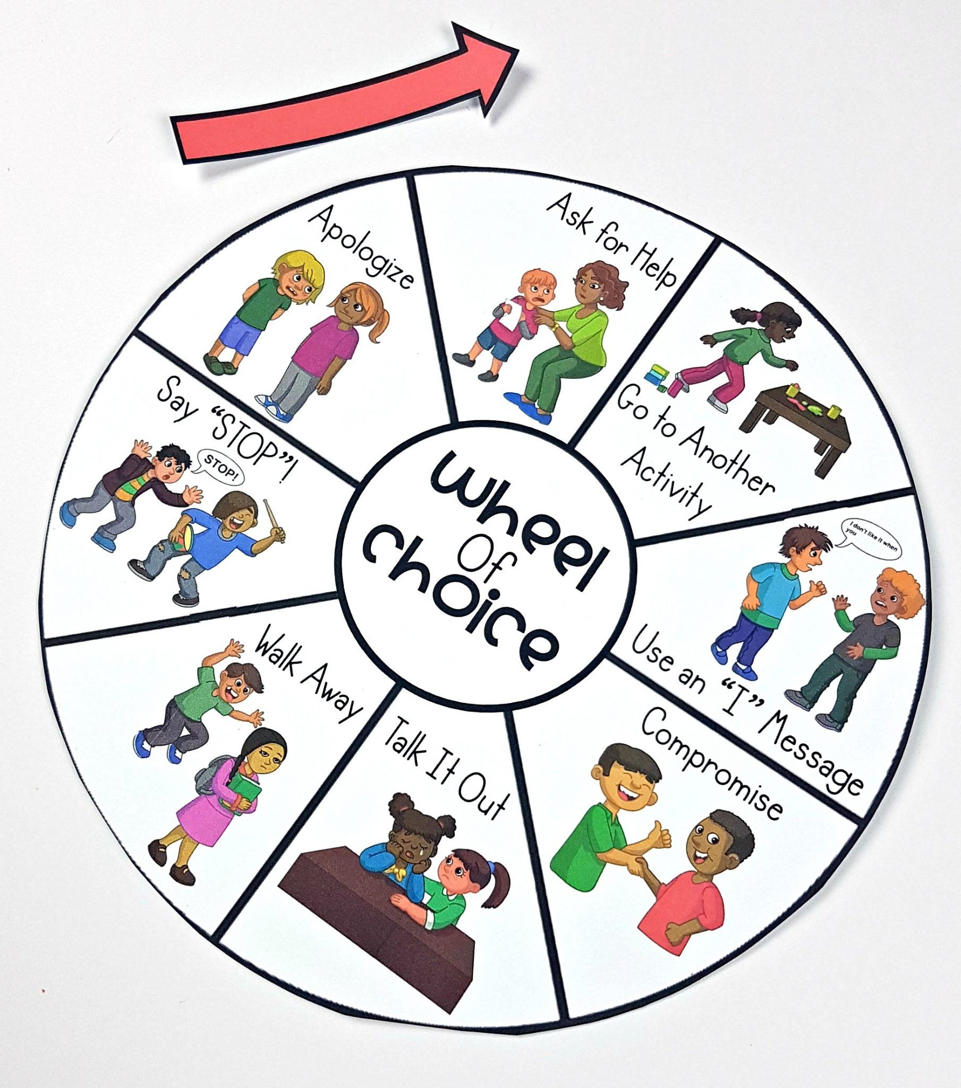
Responsible Decision Making
Responsible decision making involves learning how to make constructive choices about personal behavior and social interactions across diverse settings. It requires the ability to consider ethical standards, safety concerns, accurate behavioral norms for risky behaviors, the health and well-being of self and others, and to make realistic evaluation of various actions' consequences.
VIRTUAL ACTIVITIES:
Teach the conflict resolution process using visuals
Teach problem solving steps
Solution Kit
Notes:
Thinking through a problem and contemplating various solutions and consequences.
Encourage children to make good decisions, give them the responsibility and set them up for success with achievable goals-differentiated instruction

Slide 15
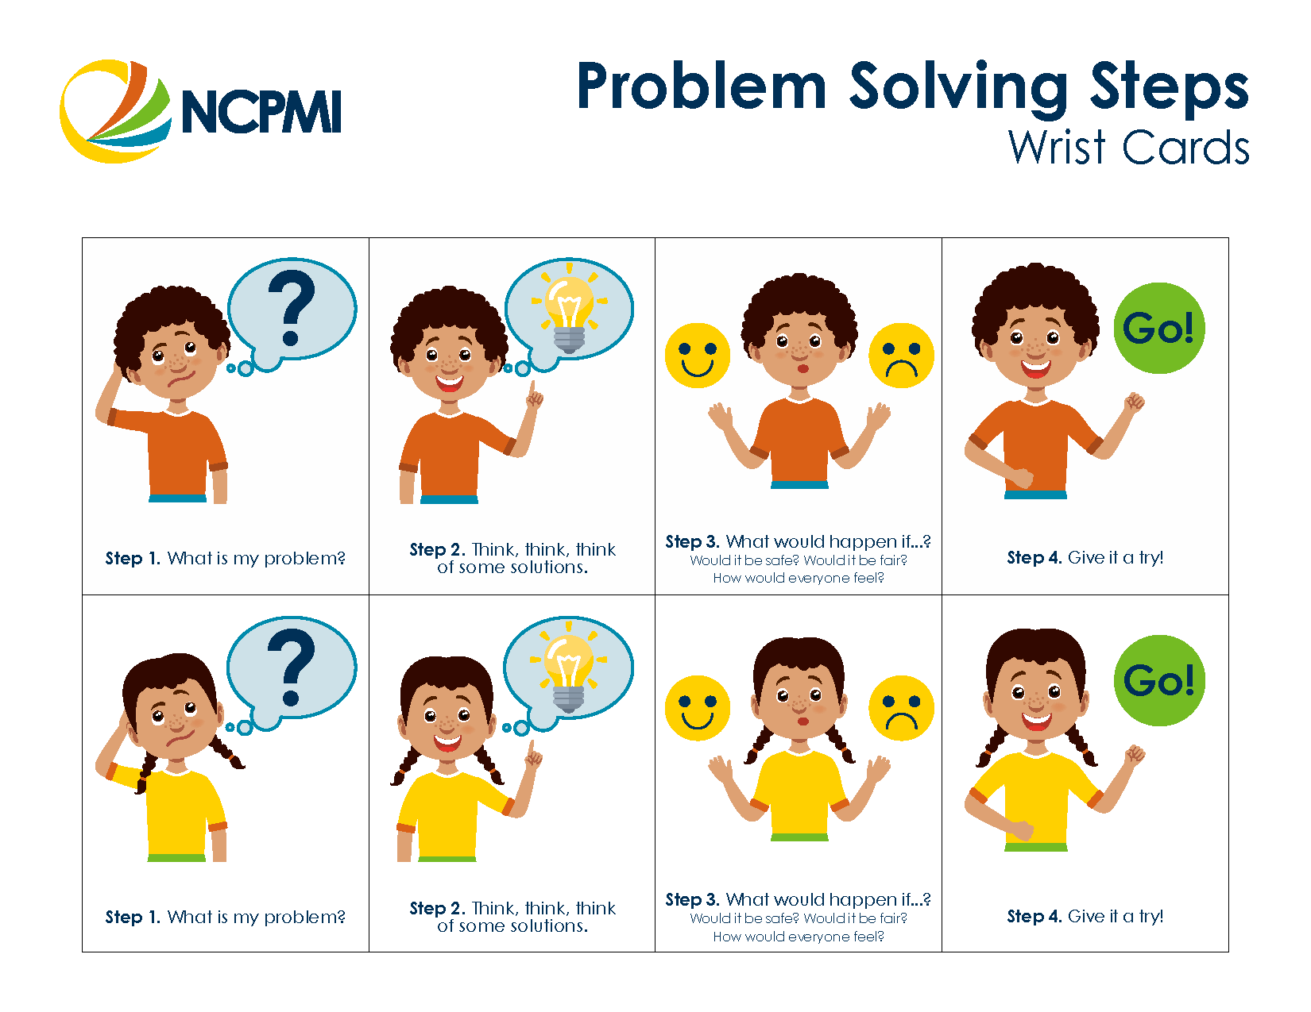

Slide 16
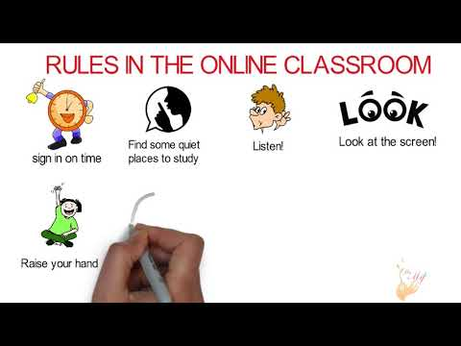
ACTIVITY: INCORPORATING SEL IN A VIRTUAL LESSON
Greeting Time-
Small Group Time-
Large Group Time-
Work Time-
Read Aloud-

Slide 17
BOOKS ON SEL
Anxiety and Grief
The Invisible String by Patrice Karst
The Don’t Worry Book by Todd Parr
The Boy with Big, Big Feelings by Britney Winn Lee and Jacob Souva
Coping with Loneliness
There’s Nothing to Do by Dev Petty
Charlotte and the Quiet Place by Deborah Sosin
Respect and Kindness
● I Am Enough by Grace Byers
● What Should Danny Do? by Adir Levy and Ganit Levy
● Kindness Snippet Jar by Diane Alber
Notes:
Show personal collection of books, talk about Glad Monster, Sad Monster with Jules ( matching activity and conversation)

Slide 18
Dealing with Emotions
Worry Says What? by Allison Edwards
The Feel Good Book by Todd Parr
I Think I Am: Teaching the Kids the Power of Affirmations by Louise Hay
The Color Monster – A Story About Emotions by Anna Llenas
Bravery
I Will Be Okay (Mindful Mantras) by Laurie N. Wright
When You are Brave by Pat Zietlow Miller
The I’m Not Scared Book by Todd Parr
Self-Growth
Be You by Peter H. Reynolds
What Were You Thinking? by Bryan Smith and Lisa M. Griffin
MySELF – Self Control & Self Esteem by Newmark Learning
Notes:
Some books might be available on YOUTUBE

Slide 19
Big concept
How are your students feeling today?
How do you feel today?
How are parents & caregivers feelings today?
What is needed to make it a GREAT day?
Before you begin...CHECK IN!
Notes:
Before you begin each day, ensure you have an understanding of everyone’s feelings for the day. Begin with yourself and then check in with your student’s and their families/caregivers so that you can support them with their needs each day/

Slide 20
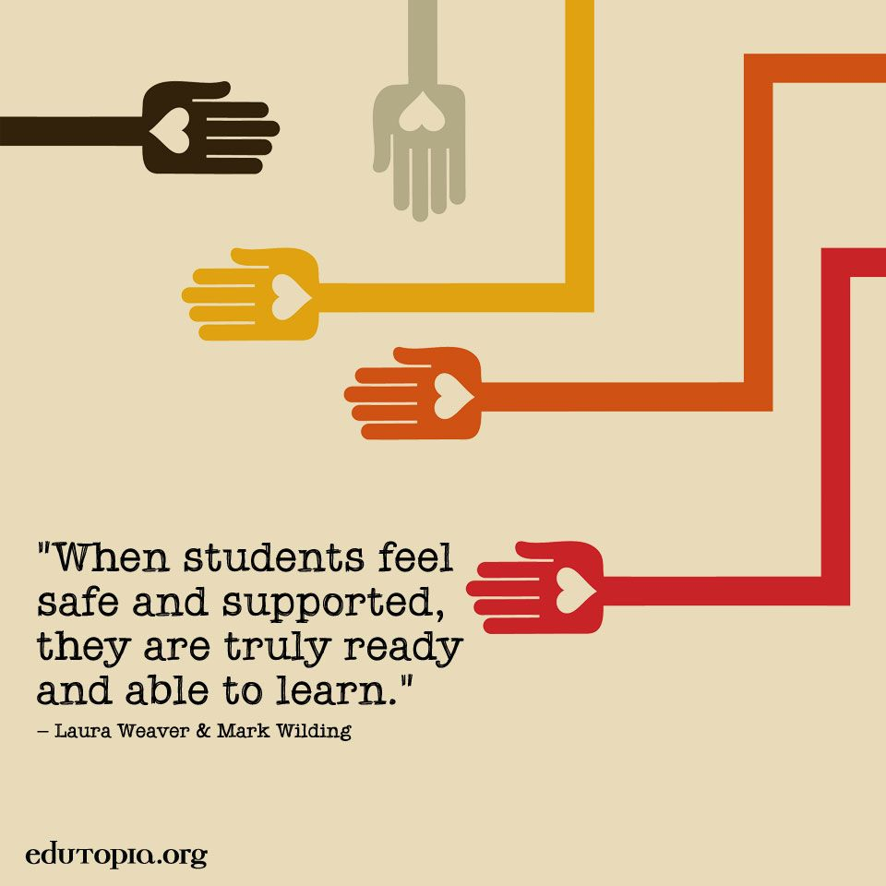
Notes:
Building rapport and trust in the beginning of the school year is important

Slide 21
RESOURCES:
https://www.centervention.com/social-emotional-learning-activities/
https://proudtobeprimary.com/social-emotional-activities-distance-learning-at-home/
https://www.edutopia.org/article/covid-19s-impact-students-academic-and-mental-well-being 28
https://www.orange.k12.nj.us/Page/25578 (PIRS webpage)
https://pureedgeinc.org/wp-content/uploads/2020/08/08.10.20-FINAL-NJ-Session-2.pdf
Bonus: Pete The Cat Read Aloud
https://www.youtube.com/watch?v=0VwfgBV_muc&feature=youtu.be&fbclid=IwAR34caDCye4LKqY9ISZgnlsNuRpZ9E1F_FoYmY7Ge6vTL0zKhkYagPBtcLs

Slide 22


Slide 23
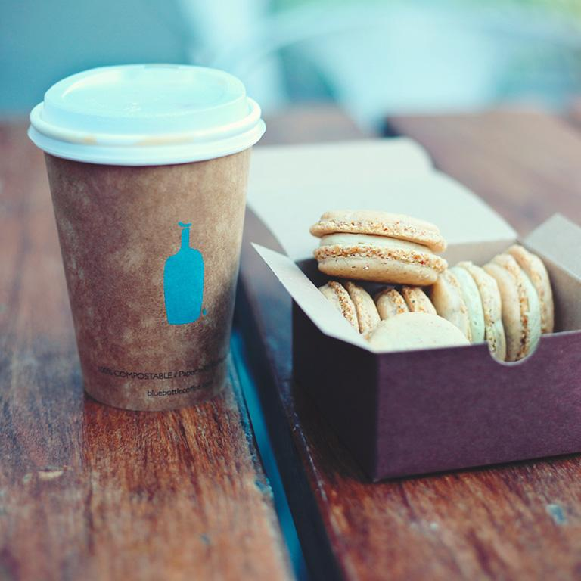
Q&A
&
Discussion

